Slide 1
Orthogonality and Least Squares
5.3 Orthogonal Projections
Bumhee Cho

Slide 2

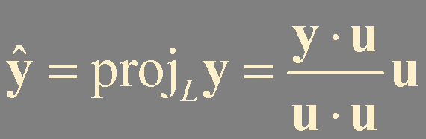
y
L
u
cu
0

Slide 3


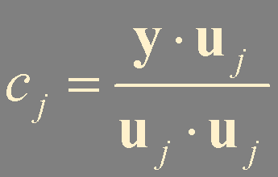





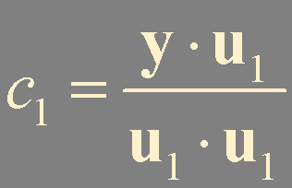

y
Theorem 5.
z
is in W
Let {u₁,…, u_{p}} be an orthogonal basis for a subspace W of ℝ^{n}. For each y in W, the weights in the linear combination
y = c₁u₁ + ⋯ + c_{p}u_{p}
z is in W⊥
0
W
are given by
{u₁,…, u_{p}} is orthogonal basis of W

Slide 4

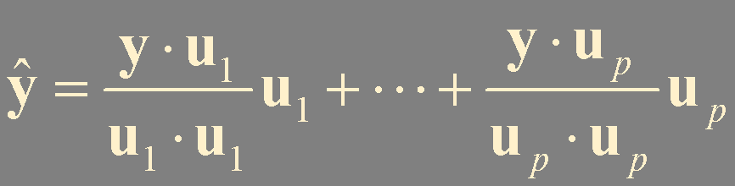

Theorem 8. The Orthogonal Decomposition Theorem
Let W be a subspace of ℝ^{n}. Then each y in ℝ^{n} can be written uniquely in the form
y = y + z
where y is in W and z is in W⊥.
In fact, if {u₁,…, u_{p}} is any orthogonal basis of W, then
and
the orthogonal projection of y onto W
proj_{W} y
If y is in W = Span {u₁,…, u_{p}}, then proj_{W} y = y

Slide 5

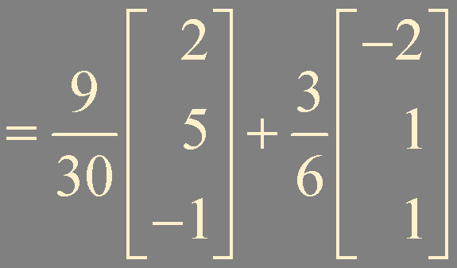
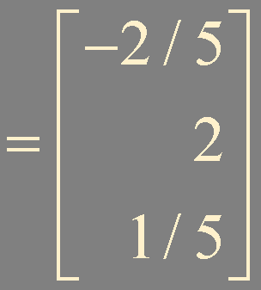
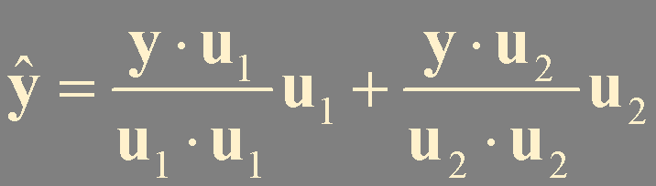
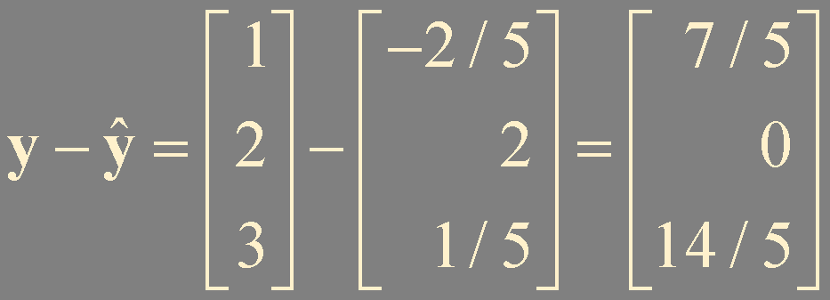
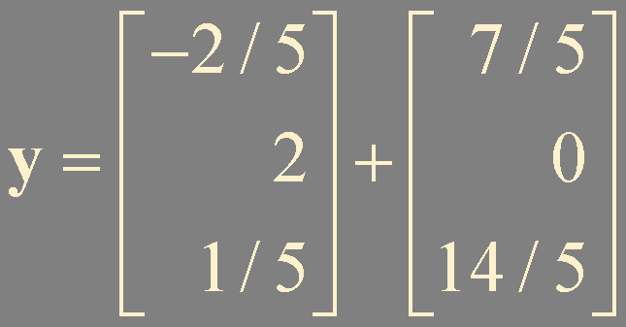
!
Example 1
?
Let u₁ = (2, 5, -1), u₂ = (-2, 1, 1), and y = (1, 2, 3). {u₁, u₂} is an orthogonal basis for W = Span {u₁, u₂}. Write y as the sum of a vector in W and a vector orthogonal W.

Slide 6

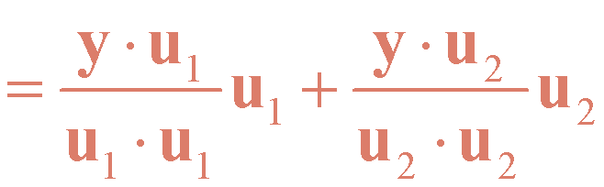



A Geometric Interpretation of the Orthogonal Projection
y
u₂
0
u₁

Slide 7



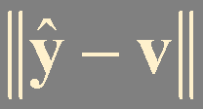
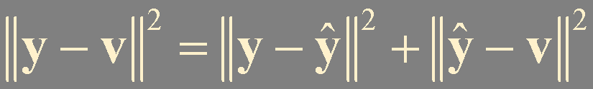
Theorem 9. The Best Approximation Theorem
Let W be a subspace of ℝ^{n}, y any vector in ℝ^{n}, and y the orthogonal projection of y onto W. Then y is the closest point in W to y, in the sense that
for all v in W distinct from y.
y
orthogonal !
||y - v||
0
the distance from y to W
v
W

Slide 8
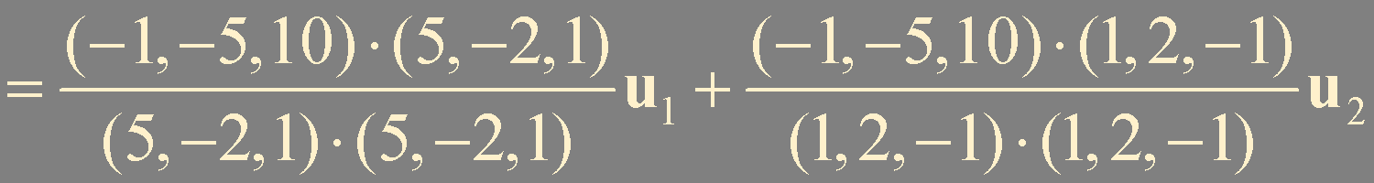
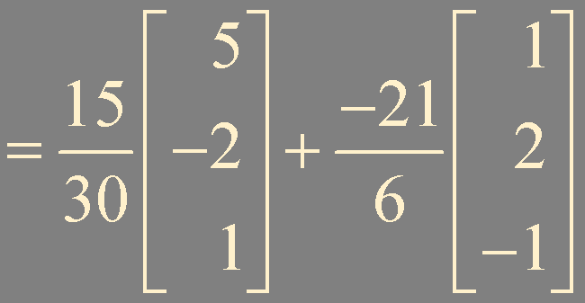
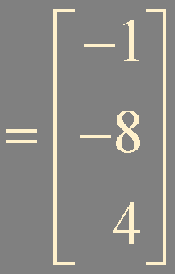
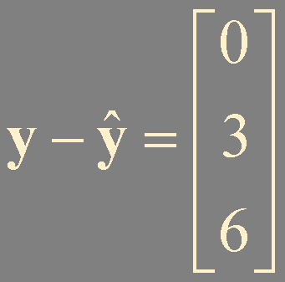

?
Example 2
!
Let u₁ = (5, -2, 1), u₂ = (1, 2, -1), y = (-1, -5, 10), and W = Span {u₁, u₂}. Find the distance from y to W.

Slide 9


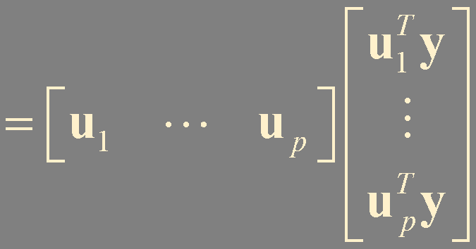
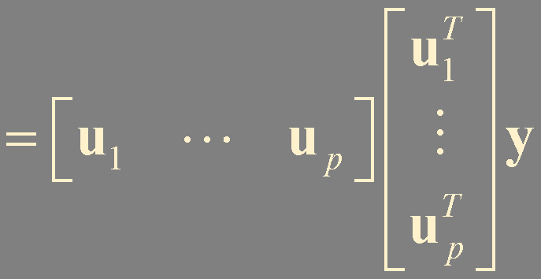

Theorem 10.
If {u₁,…, u_{p}} is an orthonormal basis for a subspace W of ℝ^{n}, then
proj_{W} y = (y⋅u₁)u₁ + (y⋅u₂)u₂ + ⋯ + (y⋅u_{p})u_{p}
If U = [u₁ u₂ ⋯ u_{p}], then
proj_{W} y = U U ^{T} y for all y in ℝ^{n}

Slide 10
Summary
Orthogonal projection

